Slide 1
Setup Google Cloud Console and Editor

Slide 2
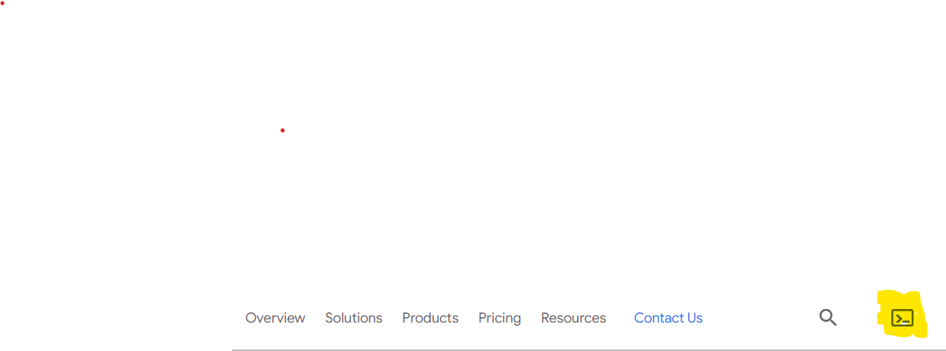
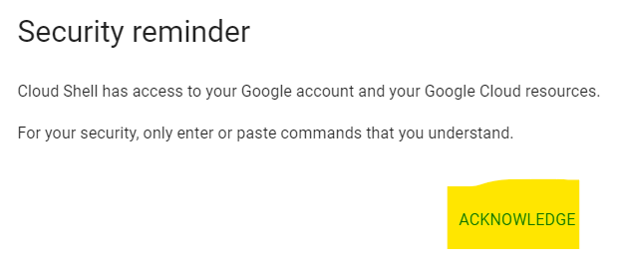
Access Google Cloud
Open Google Chrome or any other browser and navigate to the below site
https://cloud.google.com/
Sign in with your google id and password(In case you don’t have one , please create a new account.
Click on the icon “Activate Cloud Shell”
Click on the Acknowledge link, it will open the cloud shell(In case if it prompts for an authorization , please accept)

Slide 3



Open Cloud Shell and Editor
Press Ctrl key and click on Open Editor. This will open the editor in a new window
Click on the icon “Open in a new window”. This will open the cloud shell in a new window. Now you should have two tabs in the browser(one with Editor and other with Cloud shell)
Now Switch back to the editor tab and click on the icon “Close Terminal”. This will close the terminal window
One of the tab should have Editor window and other should have the Cloud Terminal

Slide 4
Setup Docker and Kubernetes(Minikube)
Navigate to the below link and setup Docker on the machine
https://www.docker.com/products/docker-desktop/
Navigate to the below site and setup minikube
https://minikube.sigs.k8s.io/docs/start/

